Slide 1
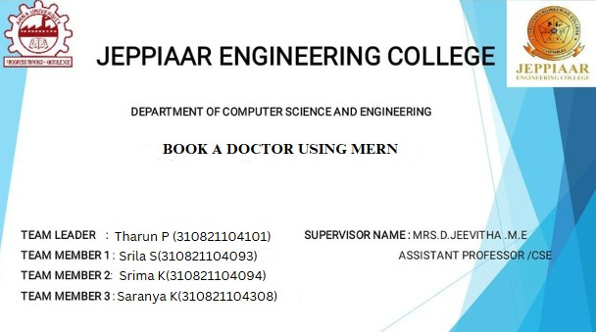

Slide 2



Project Overview
Purpose
To provide a seamless platform for patients to book doctor appointments online.
Goals
Improve patient-doctor interaction. Streamline appointment scheduling.
Key Features
User authentication and role-based access. Doctor availability check.

Slide 3

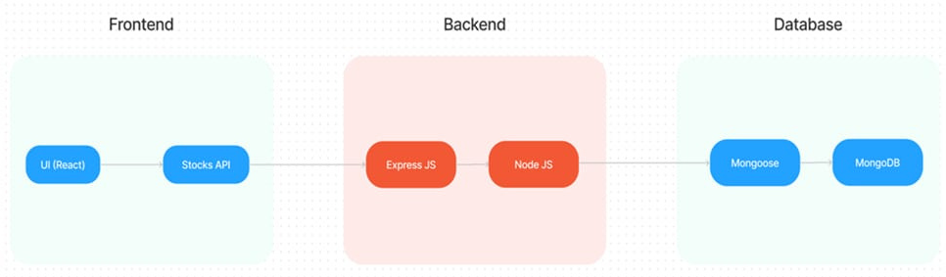
Architecture Overview
Full Stack Architecture
Frontend: React.js
Backend: Node.js & Express.js Database: MongoDB

Slide 4

Frontend Architecture
Technologies: React.js, JSX, CSS, Axios
Components
Login/Signup Dashboard
Doctor List & Profile Booking Form
State Management: UseContext

Slide 5

Backend Architecture
Technologies: Node.js, Express.js
Modules
Express Router JWT Authentication
Endpoints
/api/doctors - Fetch doctor details
/api/bookings - Handle appointments

Slide 6



Database Design
MongoDB Collections
Users: Stores user data
Doctors: Doctor profiles and availability
Appointments: Booking Details and status

Slide 7
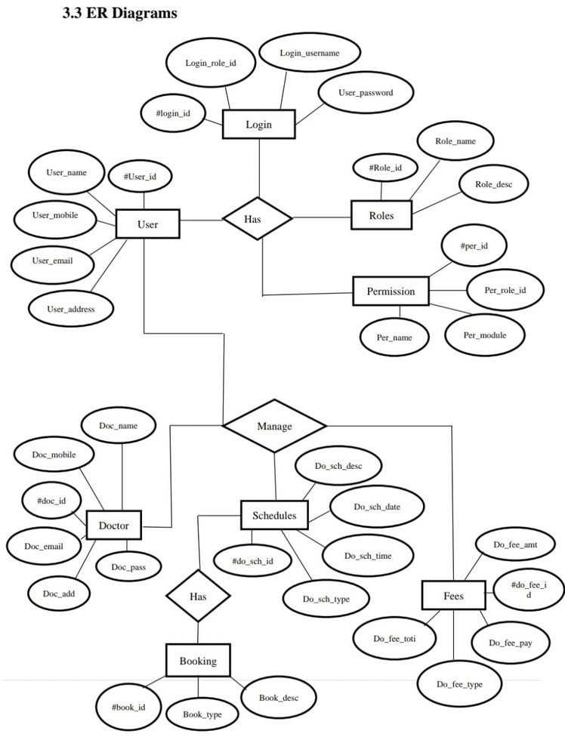



ER Diagram

Slide 8
Setup Instructions
Prerequisites
Node.js, MongoDB, IDE (VS Code)
Installation Steps
git clone https://github.com/Book_a_doctor_NM_project
cd book-doctor npm install
Set environments variables

Slide 9
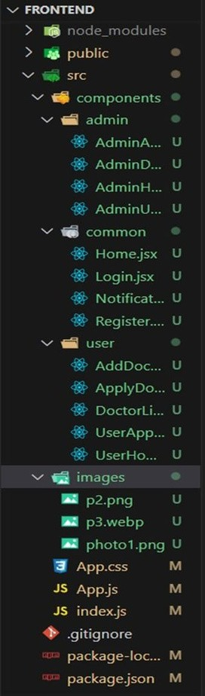
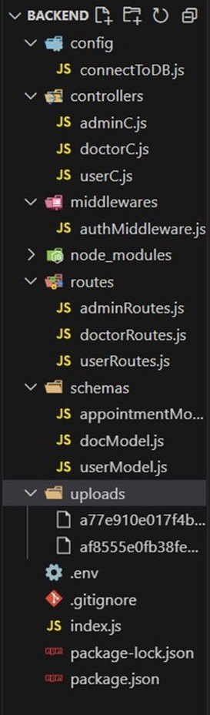



Folder Structure
Backend
Frontend

Slide 10
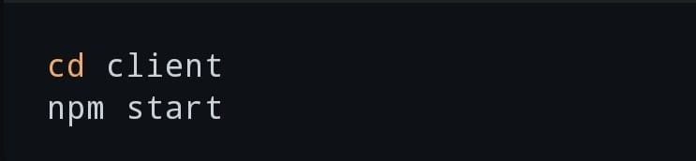
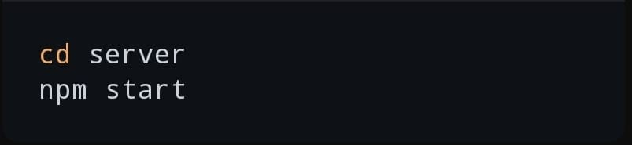
Running the application
Frontend
Backend

Slide 11

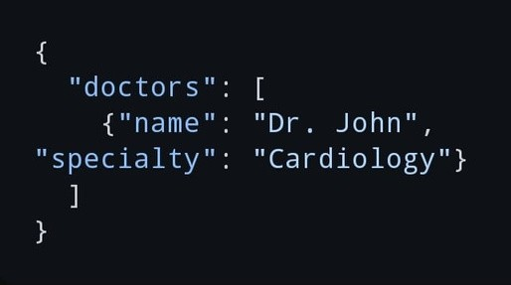
API Documentation
Endpoints
GET /api/doctors: Retrieve doctors list. POST /api/bookings: Book an appointment. Authentication: JWT tokens in headers.
Eample
GET /api/doctors Request: No parameters Response

Slide 12





Authentication & Authorization
JWT- based Authentication
Tokens generated on login Middleware to protect routes
Roles
Patients Doctors Admins

Slide 13
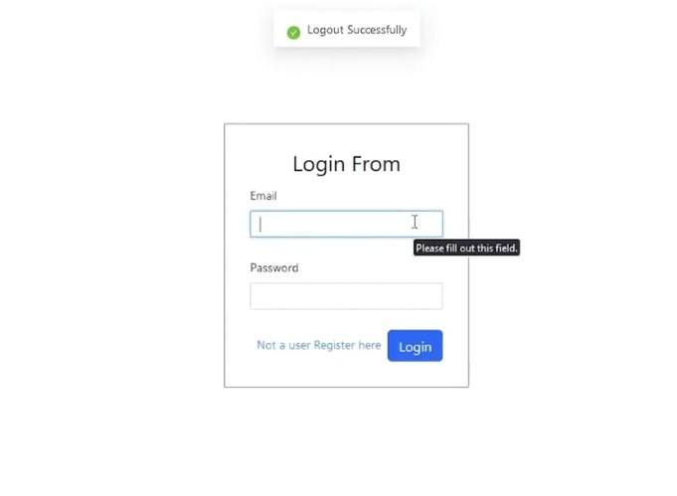
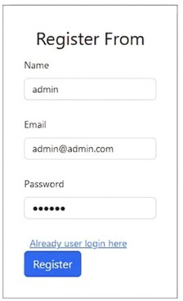

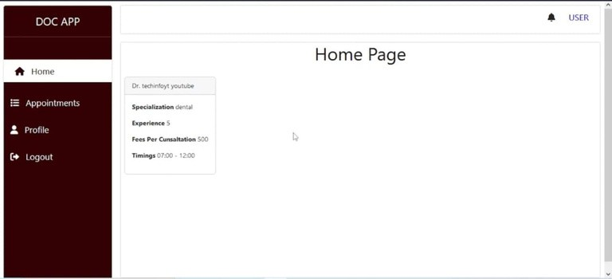
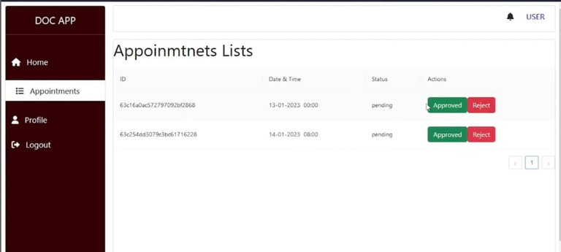
Output

Slide 14
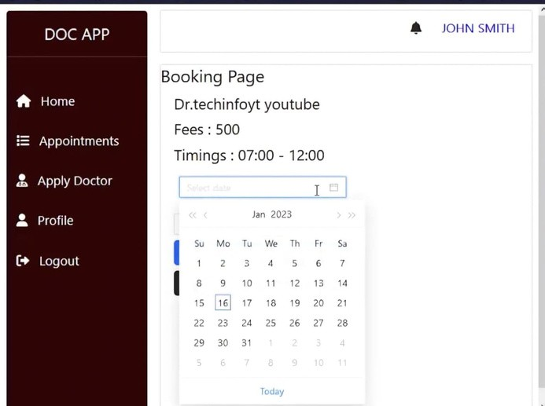
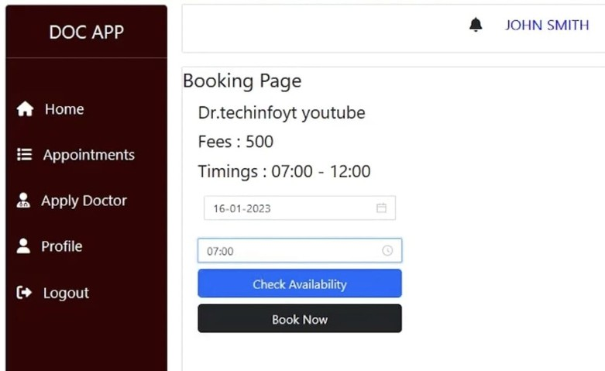

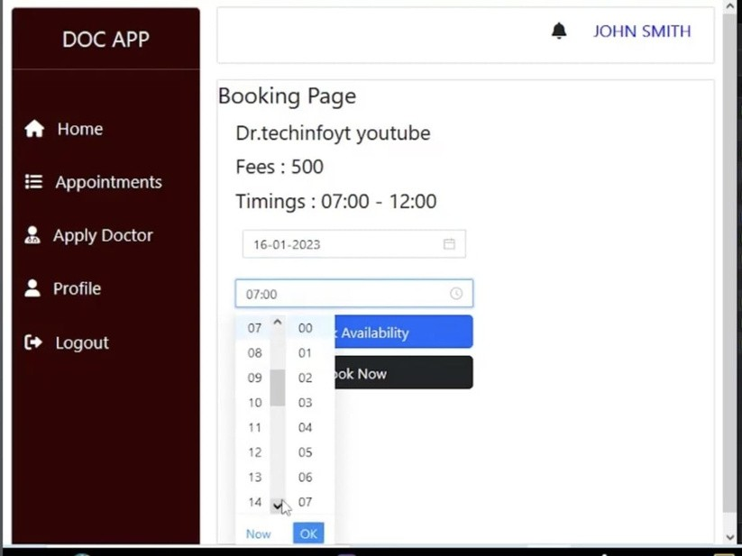

Slide 15


Future Enhancements
Telemedicine integration
Payment gatway Mobile app version

Slide 16



